Slide 1
Bachelor of Science in Computer Science University of Colombo School of Computing
SCS 1204 – Discrete Mathematics I
Topic -2: Predicate Logic

Slide 2
Topic – 2: Predicate logic
Topics to be covered.
Predicates and Quantifiers
Logical Equivalences Involving Quantifiers
Nested Quantifiers
The Order of Quantifiers
Negating Nested Quantifiers
Applications of Predicate logic

Slide 3
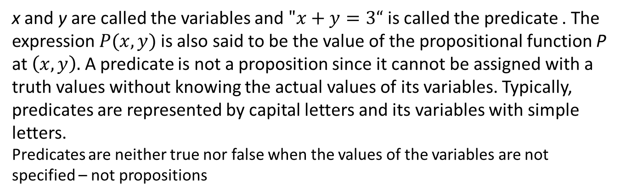
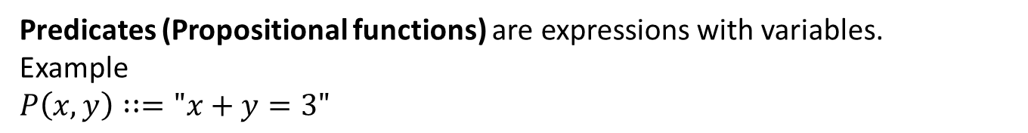

Predicates (Propositional functions)
Predicates (Propositional functions) are expressions with variables.
Example
$P\left(x,y\right)∷="x+y=3"$
x and y are called the variables and $"x+y=3“$ is called the predicate . The expression $P(x,y)$ is also said to be the value of the propositional function P at $\left(x,y\right).$ A predicate is not a proposition since it cannot be assigned with a truth values without knowing the actual values of its variables. Typically, predicates are represented by capital letters and its variables with simple letters.
Predicates are neither true nor false when the values of the variables are not specified – not propositions
Once the values have been assigned to the variables x and y, $P\left(x,y\right)$ becomes a proposition and has a truth value.
$$P\left(2,1\right)=True and P\left(3,4\right)=False$$

Slide 4
Examples
The statement “x is greater than 3” has two parts. The first part, the variable x, is the subject of the statement. The second part—the predicate, “is greater than 3”—refers to a property that the subject of the statement can have.
In general, a predicate involving the n variables x1, x2,…, xn can be denoted as
P(x1, x2,…, xn).
P(x1, x2,…, xn). is also called an n-place predicate or an n-ary predicate.
In computer programming the statements that describe valid input for a program are known as preconditions and the conditions that the output should satisfy when the program has run are known as postconditions of the program.
When the variables in a predicate(propositional function) are assigned values, the resulting statement becomes a proposition with a certain truth value

Slide 5
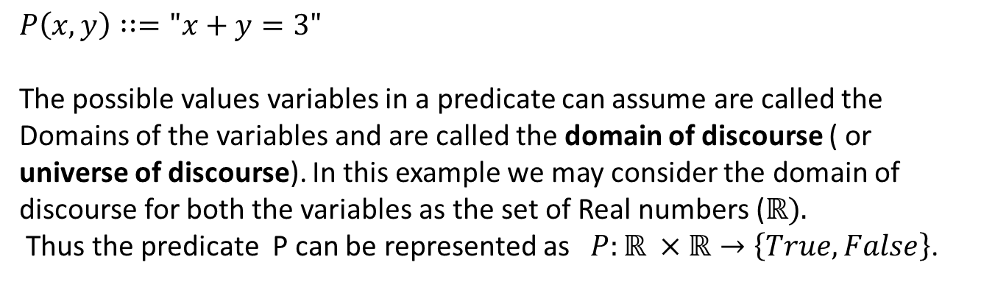
Predicates
$P\left(x,y\right)∷="x+y=3"$
The possible values variables in a predicate can assume are called the Domains of the variables and are called the domain of discourse ( or universe of discourse). In this example we may consider the domain of discourse for both the variables as the set of Real numbers ($ℝ).$
Thus the predicate P can be represented as $P:ℝ ×ℝ→\left\{True, False\right\}$.

Slide 6
Predicates
Predicates enables to
assert that a certain property holds for all objects of a certain type and/or
assert the existence of an object with a particular property
Relationship among objects.

Slide 7
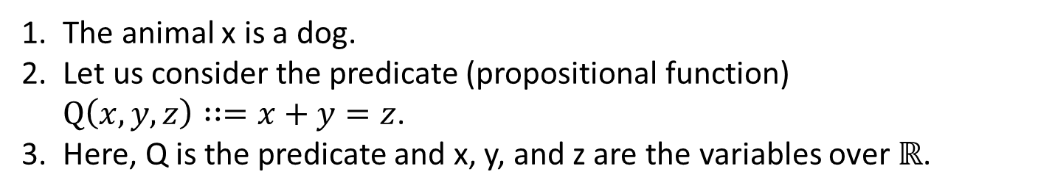
Examples of Predicates
The animal x is a dog.
Let us consider the predicate (propositional function) $Q\left(x,y,z\right)∷=x+y=z$.
Here, Q is the predicate and x, y, and z are the variables over $ℝ$.
What is the truth value of Q(2, 3, 5) ?
What is the truth value of Q(0, 1, 2) ?
A propositional function (predicate) becomes a proposition when all its variables are given values (instantiated).

Slide 8
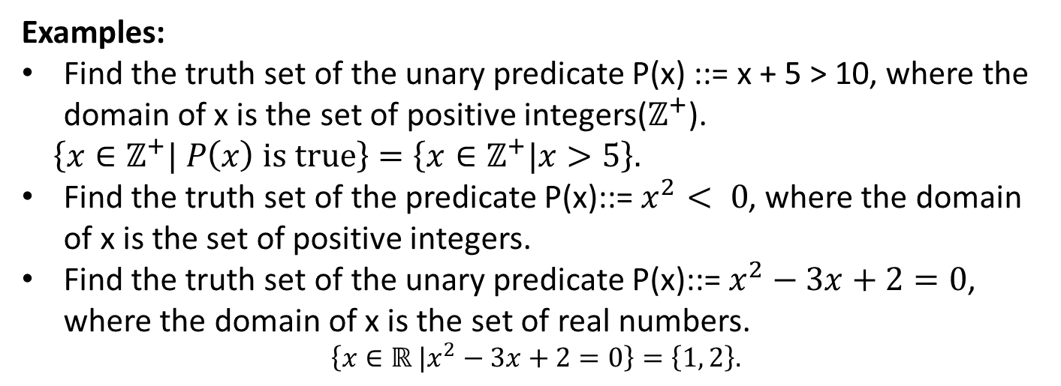
Truth set
Let P(x) be a predicate over the domain of discourse U.
P(x) could be true for all elements of U, for some elements of U, or for no elements of U.
The set of values in U for which P(x) is true is called the truth set of the predicate P(x).
Examples:
Find the truth set of the unary predicate P(x) ::= x + 5 > 10, where the domain of x is the set of positive integers($ℤ^{+}$).
$\left\{x∈ℤ^{+}| P\left(x\right) is true\right\}$ $=\left\{x∈ℤ^{+}|x>5\right\}.$
Find the truth set of the predicate P(x)::= $x^{2}< 0$, where the domain of x is the set of positive integers.
Find the truth set of the unary predicate P(x)::= $x^{2}−3x+2=0$, where the domain of x is the set of real numbers.
$$\left\{x∈ℝ |x^{2}−3x+2=0\right\}=\left\{1, 2\right\}.$$

Slide 9
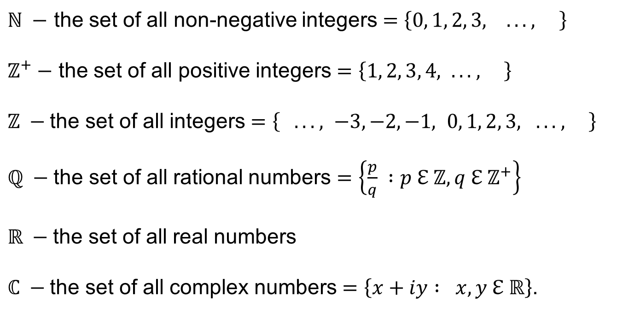
Some Common Sets
$ℕ −$ the set of all non-negative integers $=\left\{0, 1, 2, 3, . . . , \right\}$
$ℤ^{+}−$ the set of all positive integers $=\left\{1, 2, 3, 4, . . . , \right\}$
$ℤ −$the set of all integers $=\left\{ . . . , −3, −2, −1, 0, 1, 2, 3, . . . , \right\}$
$ℚ −$the set of all rational numbers $=\left\{\frac{p}{q} :p ℇ ℤ, q ℇ{ ℤ}^{+}\right\}$
$ℝ −$the set of all real numbers
$ℂ −$the set of all complex numbers $=\left\{x+iy : x, y ℇ ℝ\right\}$.

Slide 10
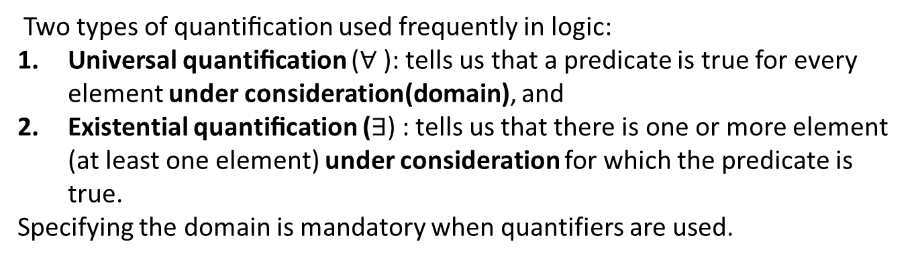
Quantifiers
Quantiﬁcation expresses the extent to which a predicate is true over a range of elements. Using quantifiers propositions can be created from propositional functions.
In English, the words all, some, many, none, and few are used in quantiﬁcations.
Two types of quantiﬁcation used frequently in logic:
Universal quantiﬁcation ($∀$): tells us that a predicate is true for every element under consideration(domain), and
Existential quantiﬁcation ($∃$) : tells us that there is one or more element (at least one element) under consideration for which the predicate is true.
Specifying the domain is mandatory when quantifiers are used.
The area of logic that deals with predicates and quantiﬁers is called the predicate calculus (predicate logic or first order logic).

Slide 11
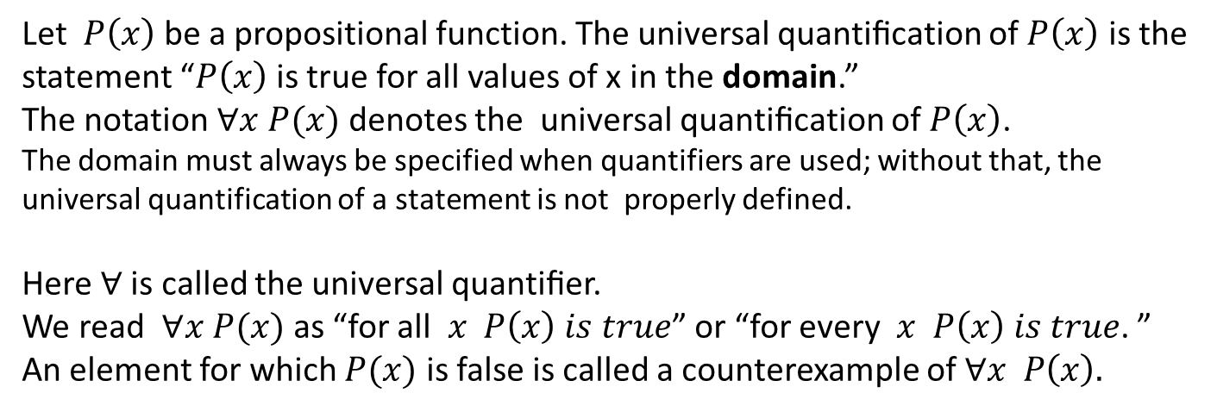
The Universal Quantifier
Let $P\left(x\right)$be a propositional function. The universal quantiﬁcation of $P\left(x\right)$ is the statement “$P\left(x\right)$ is true for all values of x in the domain.”
The notation $∀x P(x)$ denotes the universal quantiﬁcation of $P\left(x\right)$.
The domain must always be specified when quantifiers are used; without that, the universal quantification of a statement is not properly defined.
Here $∀$is called the universal quantiﬁer.
We read $∀x P(x)$as “for all $x P\left(x\right) is true$” or “for every $x P\left(x\right) is true$. ”
An element for which $P(x)$ is false is called a counterexample of $∀x P\left(x\right).$
Examples: $∀x εℝ, x+1>x$ is a True proposition.
$∀x∈ℝ x^{2}≥x$ is not a True proposition. (.2² =.04 > .2 is False)
$However, ∀x∈ℤ x^{2}≥x$ is a True proposition.

Slide 12
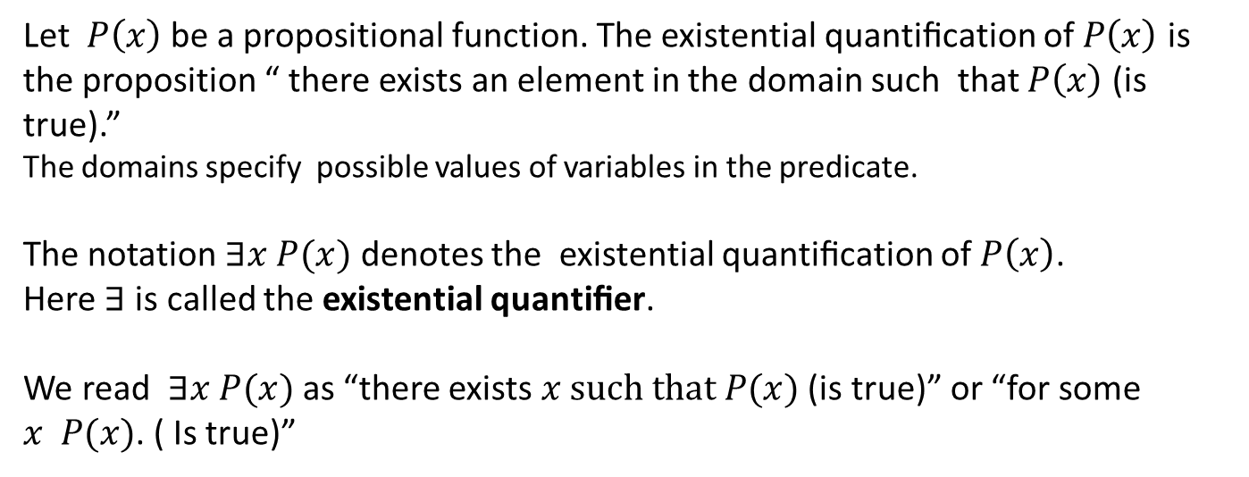
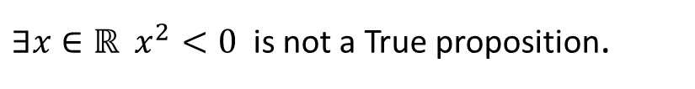
The Existential Quantifier
Let $P\left(x\right)$be a propositional function. The existential quantiﬁcation of $P\left(x\right)$ is the proposition “ there exists an element in the domain such that $P\left(x\right)$ (is true).”
The domains specify possible values of variables in the predicate.
The notation $∃x P(x)$ denotes the existential quantiﬁcation of $P\left(x\right)$.
Here $∃$is called the existential quantiﬁer.
We read $∃x P(x)$as “there exists $x such that P(x)$ (is true)” or “for some $x P(x)$. ( Is true)”
The proposition $∃x P(x)$ is false if and only if there is no element x in the domain for which $P\left(x\right)$ is true.
Examples:$∃x εℝ, x>3$ is a True proposition.
$∃x∈ℝ x^{2}<0$ is not a True proposition.

Slide 13
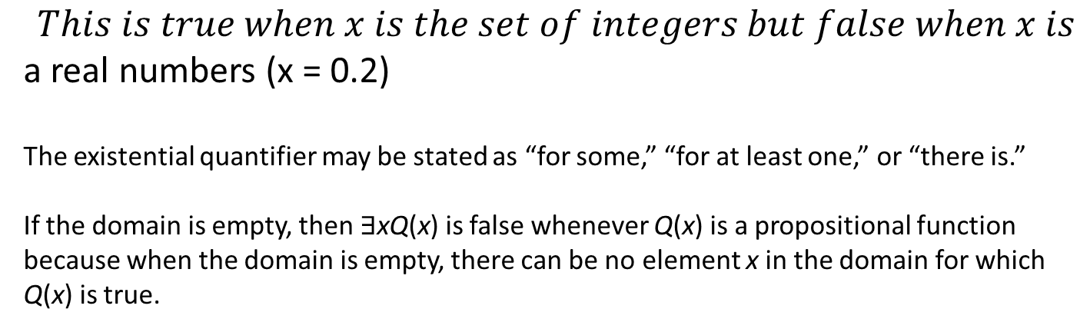
The Existential Quantifier
The meaning of ∃xP(x) changes when the domain changes. Without specifying the domain, the statement ∃xP(x) has no meaning.
Example:
x² > 0
$$This is true when x is the set of integers but false when x is$$
a real numbers (x = 0.2)
The existential quantifier may be stated as “for some,” “for at least one,” or “there is.”
If the domain is empty, then ∃xQ(x) is false whenever Q(x) is a propositional function because when the domain is empty, there can be no element x in the domain for which
Q(x) is true.

Slide 14
The Existential Quantifier
∃xP(x) can be read as
“There is an x (in the domain) such that P(x) (is true)”
“There is at least one x (in the domain) such that P(x) (true)”
“For some x P(x).”
If the domain is empty, then ∃xQ(x) is false whenever Q(x) is a propositional function because when the domain is empty, there can be no element x in the domain for which Q(x) is true.

Slide 15
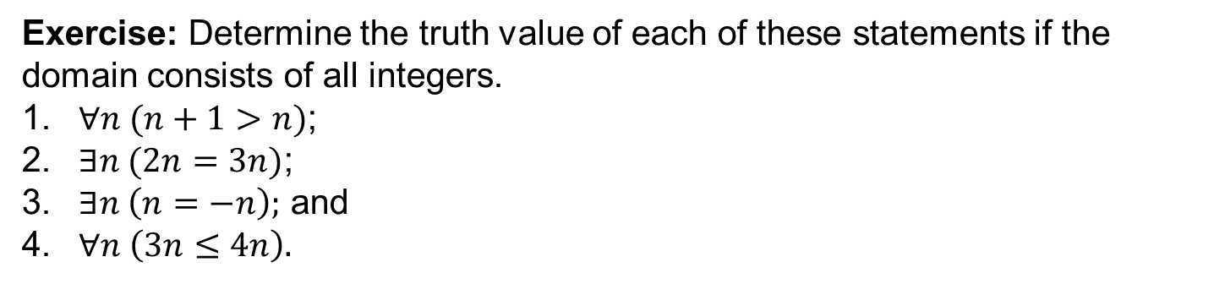
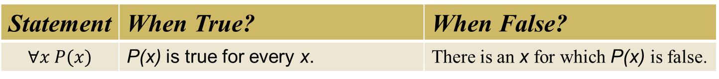
Meaning of the universal and Existential Quantifiers
Statement | When True? | When False?
$$∀x P(x)$$ | P(x) is true for every x. | There is an x for which P(x) is false.
$$∃x P(x)$$ | There is an x for which P(x) is true. | P(x) is false for every x.
Exercise: Determine the truth value of each of these statements if the domain consists of all integers.
$∀n (n+1>n)$;
$∃n (2n=3n)$;
$∃n \left(n=−n\right);$ and
$∀n \left(3n≤4n\right).$

Slide 16
Example
Let P(x) be the statement “x + 1 > x.” What is the truth value of the quantification ∀xP(x), where the domain consists of all real numbers?
Because P(x) is true for all real numbers x, the quantification ∀x P(x) is true
Generally, an implicit assumption is made that all domains of discourse for quantifiers are nonempty. Note that if the domain is empty, then ∀xP(x) is true for any propositional function P(x) because there are no elements x in the domain for which P(x) is false.
universal quantification can be expressed in many other ways such as “all of,” “for each,” “given any,” “for arbitrary,” “for each,” and “for any”.

Slide 17
Example
Suppose that P(x) is “x² > 0.” . Show that the statement ∀xP(x) is false where the universe of discourse consists of all integers.
Giving the counter example example x = 0 is sufficient to prove that ∀xP(x) is false.

Slide 18
Quantifiers - Summary
Statement | When True | When False
∀xP(x) | P(x) is true for every x. | There is an x for which P(x) is false.
∃xP(x) | There is an x for which P(x) is true. | P(x) is false for every x.

Slide 19







Example
Let the universe be the set of integers and let
N(x) := “ x is a non-negative integer”, E(x): = “ x is even”,
O(x): = “ x is odd” , and P(x): = “ x is prime”.
Express each of these statements in terms of N(x), E(x), O(x), P(x), quantiﬁers, and logical connectives.
There exists an even integer.
All prime integers are non-negative.
Every integer is even or odd.
Not all integers are odd.
Not all primes are odd.
If an integer is not odd, then it is even.
The only even prime is 2.
$$∃x E(x)$$
$$∀x (P\left(x\right)→N\left(x\right))$$
$$∀x (E\left(x\right)∨O\left(x\right))$$
$$¬[∀x O\left(x\right)]$$
$$¬[∀x (P(x)→O\left(x\right)]$$
$$∀x (¬O\left(x\right)→E\left(x\right))$$
$$∀x \left[\left(P\left(x\right)∧E\left(x\right)\right)→x=2\right].$$

Slide 20
Precedence of quantifiers
The quantifiers ∀ and ∃ have higher precedence than all logical operators.
example:
∀xP(x) ∨ Q(x) is the disjunction of ∀xP(x) and Q(x).
this means (∀xP(x)) ∨ Q(x) not ∀x(P(x) ∨ Q(x)).

Slide 21


Negations of Quantified Statements
Everyone likes football.
What is the negation of this proposition?
Not everyone likes football = There exists someone who doesn’t like football.
$$¬ \left(∀x P\left(x\right)\right)≡∃x ¬ P(x)$$
There is a plant that can fly.
What is the negation of this proposition?
Not exists a plant that can fly = every plant cannot fly.
$$¬ \left(∃x P\left(x\right)\right)≡∀x ¬ P(x)$$

Slide 22

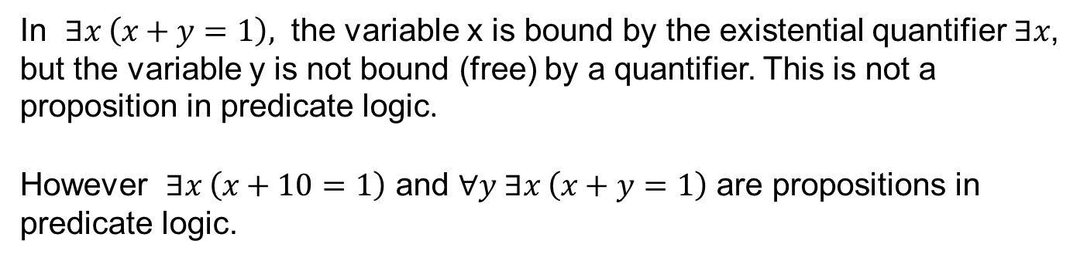
Binding and Scope of Variables
In $∃x \left(x+y=1\right),$ the variable x is bound by the existential quantifier $∃x$, but the variable y is not bound (free) by a quantifier. This is not a proposition in predicate logic.
However $∃x \left(x+10=1\right)$ and $∀y ∃x \left(x+y=1\right)$ are propositions in predicate logic.
$$∀x\left[\underset{Scope for x}{\underbrace{∀y \underset{scope for y }{\underbrace{xy=x} →x=0}}}\right]$$

Slide 23
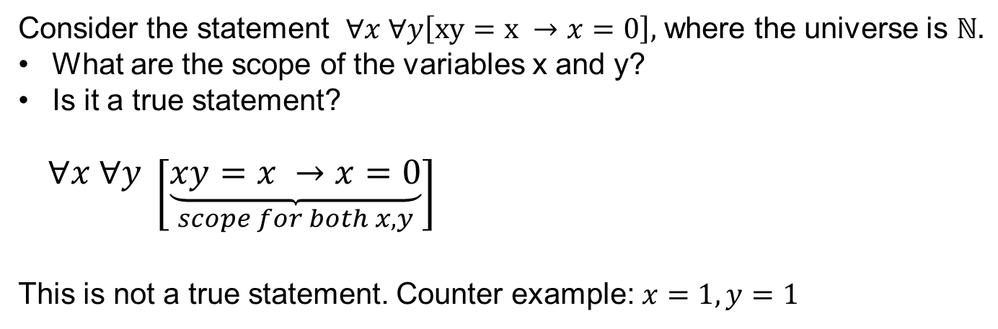
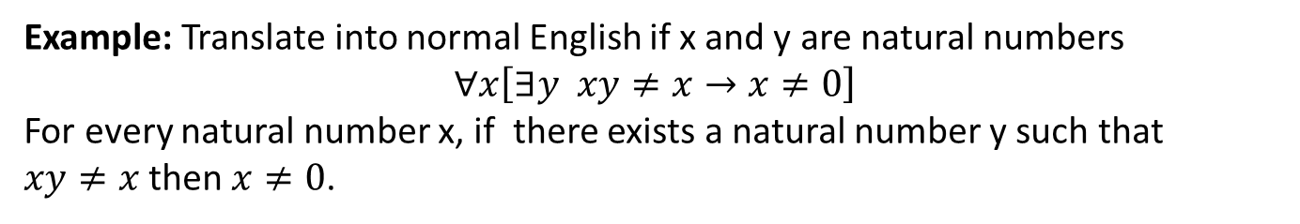
More Examples
Consider the statement $∀x ∀y\left[xy=x →x=0\right],$ where the universe is $ℕ.$
What are the scope of the variables x and y?
Is it a true statement?
$∀x ∀y \left[\underset{scope for both x,y}{\underbrace{xy=x →x=0}}\right]$
This is not a true statement. Counter example: $x=1, y=1$
Example: Translate into normal English if x and y are natural numbers
$$∀x\left[∃y xy≠x→x≠0\right]$$
For every natural number x, if there exists a natural number y such that
$xy≠x$ then $x≠0$.

Slide 24
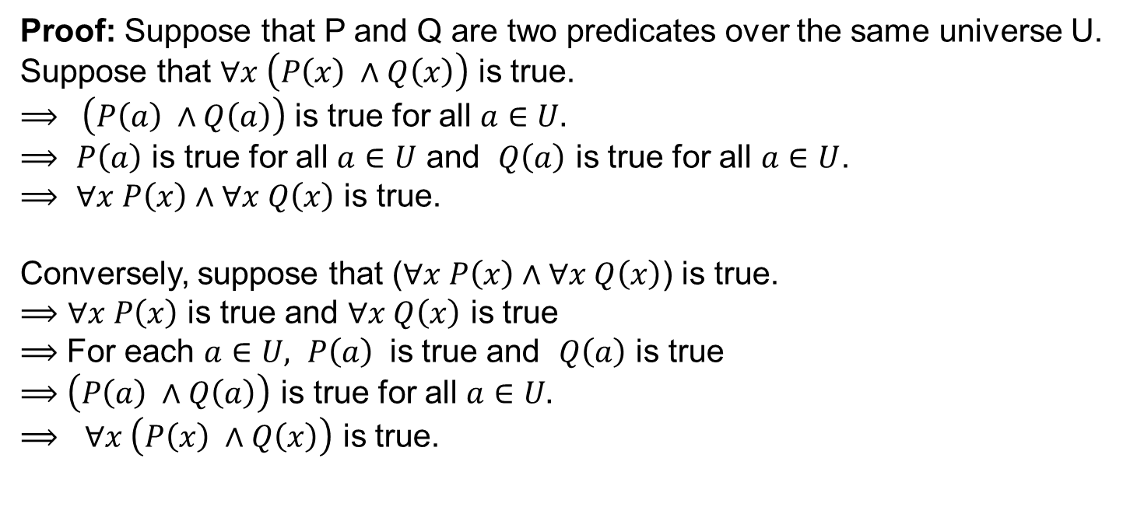
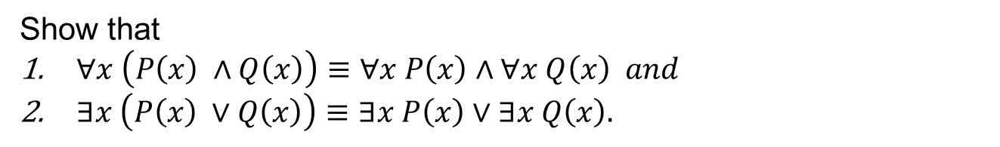
Logical Equivalences Involving Quantiﬁers
Show that
$∀x \left(P\left(x\right) ∧Q\left(x\right)\right)≡∀x P\left(x\right)∧∀x Q\left(x\right) and$
$∃x \left(P\left(x\right) ∨Q\left(x\right)\right)≡∃x P\left(x\right)∨∃x Q\left(x\right).$
Proof: Suppose that P and Q are two predicates over the same universe U.
Suppose that $∀x \left(P\left(x\right) ∧Q\left(x\right)\right)$ is true.
$⟹ \left(P\left(a\right) ∧Q\left(a\right)\right)$ is true for all $a∈U.$
$⟹$ $P\left(a\right)$ is true for all $a∈U$ and $Q\left(a\right)$ is true for all $a∈U$.
$⟹$ $∀x P\left(x\right)∧∀x Q\left(x\right)$ is true.
Conversely, suppose that ($∀x P\left(x\right)∧∀x Q\left(x\right)$) is true.
$⟹∀x P\left(x\right)$ is true and $∀x Q\left(x\right)$ is true
$⟹$ For each $a∈U, P\left(a\right)$ is true and $Q\left(a\right)$ is true
$⟹$ $\left(P\left(a\right) ∧Q\left(a\right)\right)$ is true for all $a∈U.$
$⟹$ $∀x \left(P\left(x\right) ∧Q\left(x\right)\right)$ is true.

Slide 25
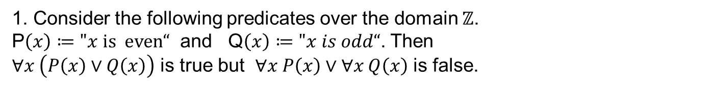
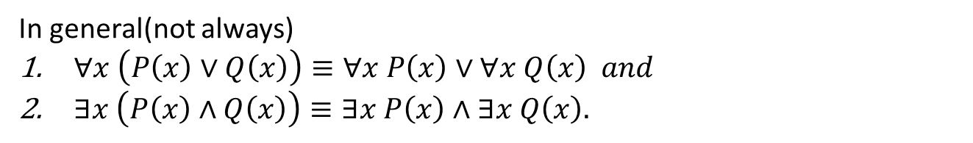
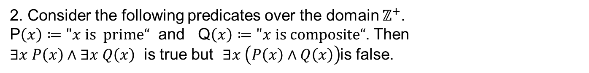
Examples
In general(not always)
$∀x \left(P\left(x\right)∨Q\left(x\right)\right)≡∀x P\left(x\right)∨∀x Q\left(x\right) and$
$∃x \left(P\left(x\right)∧Q\left(x\right)\right)≡∃x P\left(x\right)∧∃x Q\left(x\right).$
1. Consider the following predicates over the domain $ℤ$.
P$\left(x\right)≔"x is even“$ and Q$\left(x\right)≔"x is odd“$. Then
$∀x \left(P\left(x\right)∨Q\left(x\right)\right)$ is true but $∀x P\left(x\right)∨∀x Q\left(x\right)$ is false.
2. Consider the following predicates over the domain $ℤ^{+}$.
P$\left(x\right)≔"x is prime“$ and Q$\left(x\right)≔"x is composite“$. Then
$∃x P\left(x\right)∧∃x Q\left(x\right)$ is true but $∃x \left(P\left(x\right)∧Q\left(x\right)\right)$is false.

Slide 26
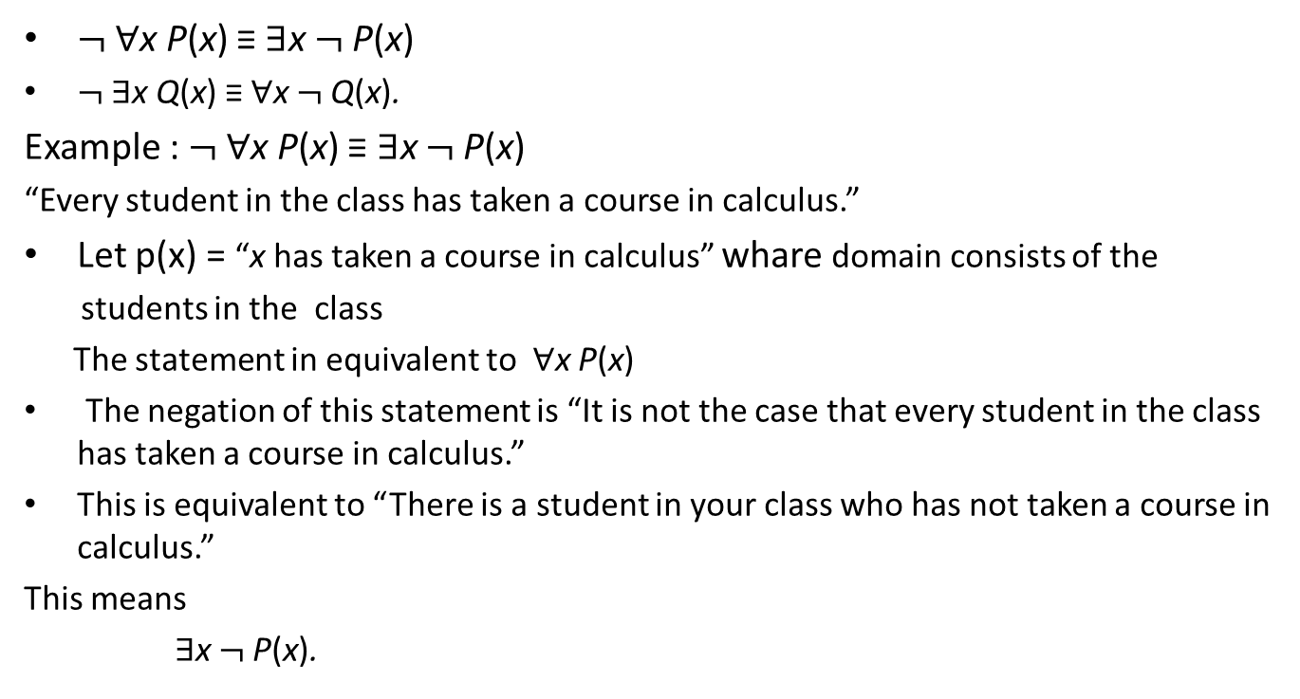
Negation of quantifiers
$¬$∀x P(x) ≡ ∃x $¬$P(x)
$¬$∃x Q(x) ≡ ∀x $¬$Q(x).
Example : $¬$∀x P(x) ≡ ∃x $¬$P(x)
“Every student in the class has taken a course in calculus.”
Let p(x) = “x has taken a course in calculus” whare domain consists of the
students in the class
The statement in equivalent to ∀x P(x)
The negation of this statement is “It is not the case that every student in the class has taken a course in calculus.”
This is equivalent to “There is a student in your class who has not taken a course in calculus.”
This means
∃x $¬$P(x).

Slide 27
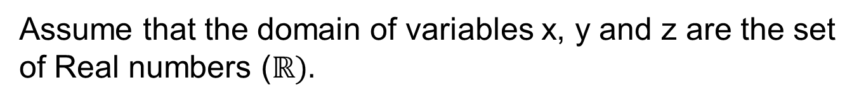
Nested Quantiﬁers
Assume that the domain of variables x, y and z are the set of Real numbers ($ℝ).$
$$∀x ∀y \left(x+y=y+x\right) the commutative law for addition$$
$∀x ∀y ∀z \left(x+\left(y+z\right)=\left(x+y\right)+z\right)$ $the accosiative law for addition$
$∀x ∃y \left(x+y=0\right)$ the existence of additive inverse.

Slide 28
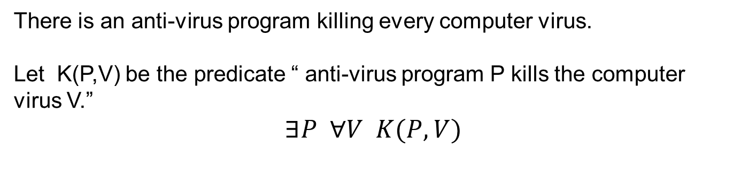
Nested Quantifiers
There is an anti-virus program killing every computer virus.
Let K(P,V) be the predicate “ anti-virus program P kills the computer virus V.”
$$∃P ∀V K(P,V)$$
What is the meaning of $∀V ∃P, K\left(P,V\right)?$
For every computer virus, there is an anti-virus program that kills it.
Order of quantifiers is very important!

Slide 29
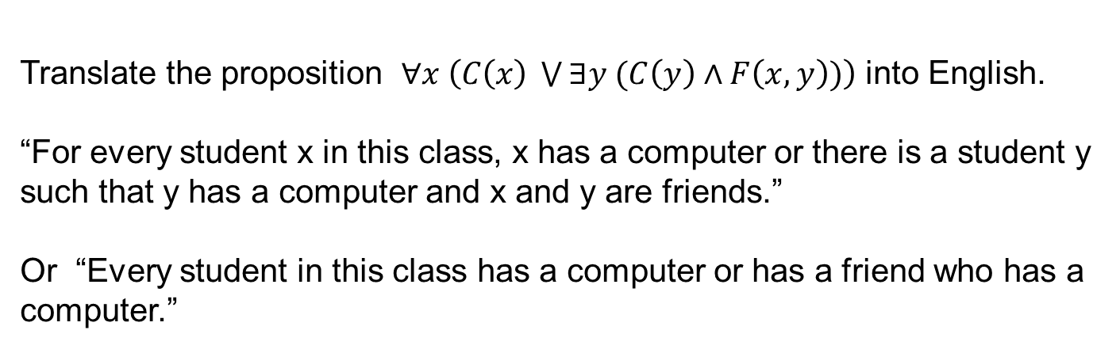
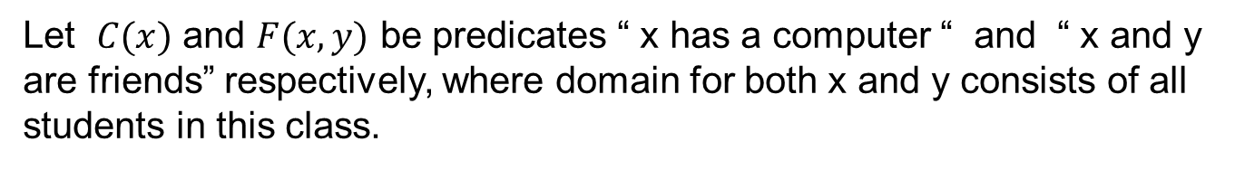
Nested Quantiﬁers into English
Let $C(x)$ and $F(x,y)$ be predicates “ x has a computer “ and “ x and y are friends” respectively, where domain for both x and y consists of all students in this class.
Translate the proposition $∀x \left(C\left(x\right) \bigvee{∃y (C\left(y\right)∧F\left(x,y\right))}\right)$ into English.
“For every student x in this class, x has a computer or there is a student y such that y has a computer and x and y are friends.”
Or “Every student in this class has a computer or has a friend who has a computer.”

Slide 30
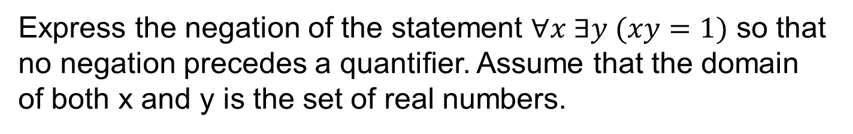



Negating Nested Quantiﬁers
Express the negation of the statement $∀x ∃y (xy=1)$ so that no negation precedes a quantiﬁer. Assume that the domain of both x and y is the set of real numbers.
$$¬\left(∀x ∃y \left(xy=1\right)\right)$$
$$≡ ∃x ¬\left(∃y \left(xy=1\right)\right)$$
$$≡ ∃x ∀y (¬\left(xy=1\right))$$
$$≡ ∃x ∀y \left( xy ≠1\right).$$

Slide 31
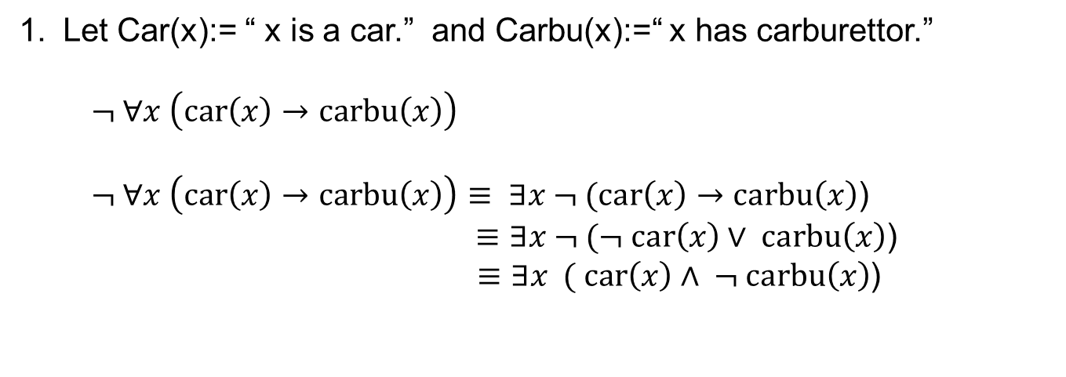
Exercise
Express each of these statements using quantifiers, logical connectives, and predicates; first using only universal quantifier and then only using existential quantifier.
Not all cars have carburettors.
No dogs are intelligent.
Some numbers are not real.
Let Car(x):= “ x is a car.” and Carbu(x):=“ x has carburettor.”
$¬ ∀x \left(car\left(x\right)→carbu\left(x\right)\right)$
$¬ ∀x \left(car\left(x\right)→carbu\left(x\right)\right)≡ ∃x ¬ (car\left(x\right)→carbu\left(x\right)$)
$≡∃x ¬ (¬ car\left(x\right)∨ carbu\left(x\right)$)
$≡∃x ( car\left(x\right)∧ ¬ carbu\left(x\right)$)

